Slide 1
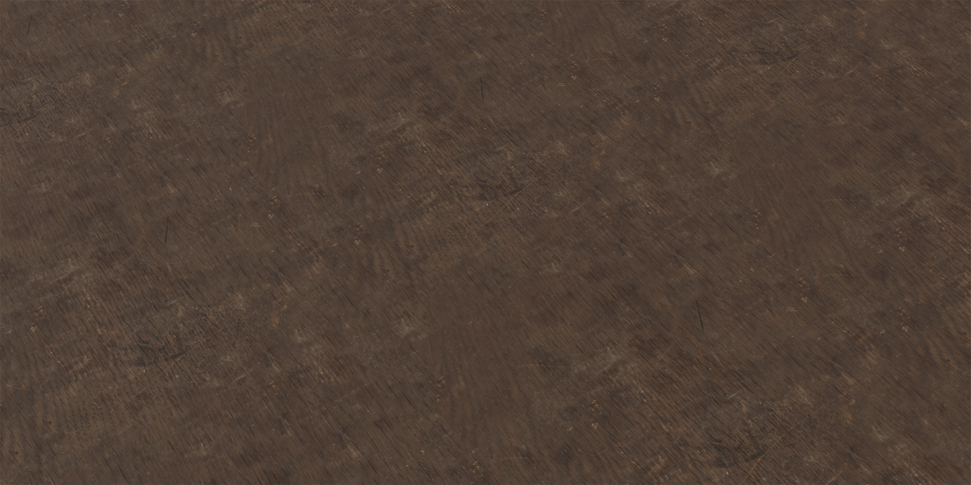
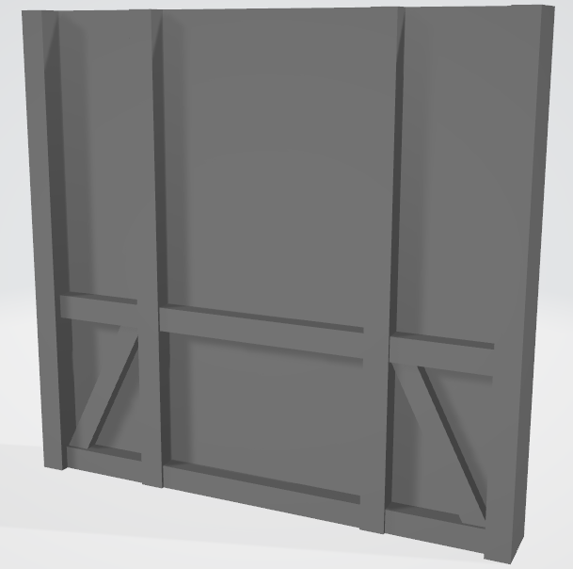
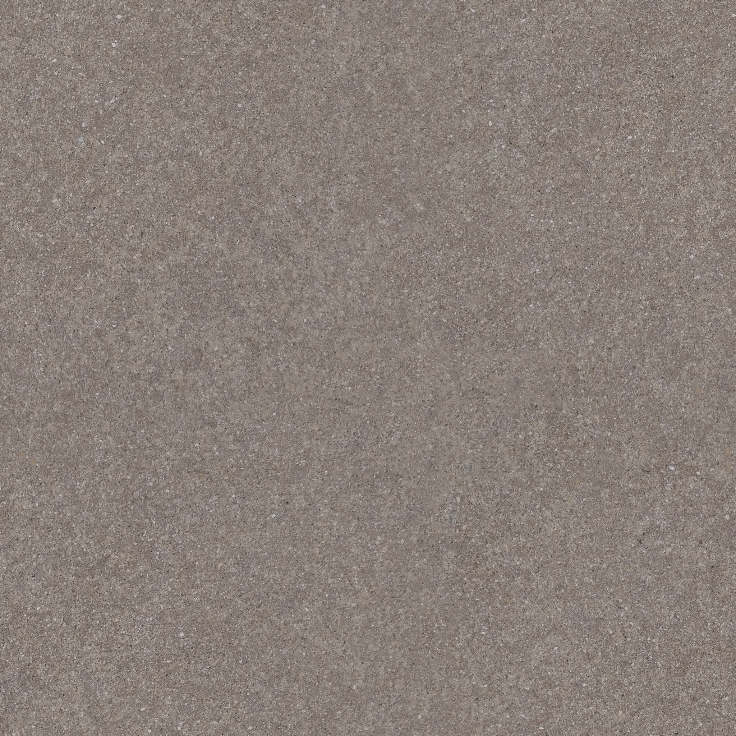
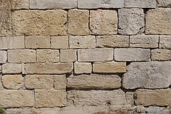
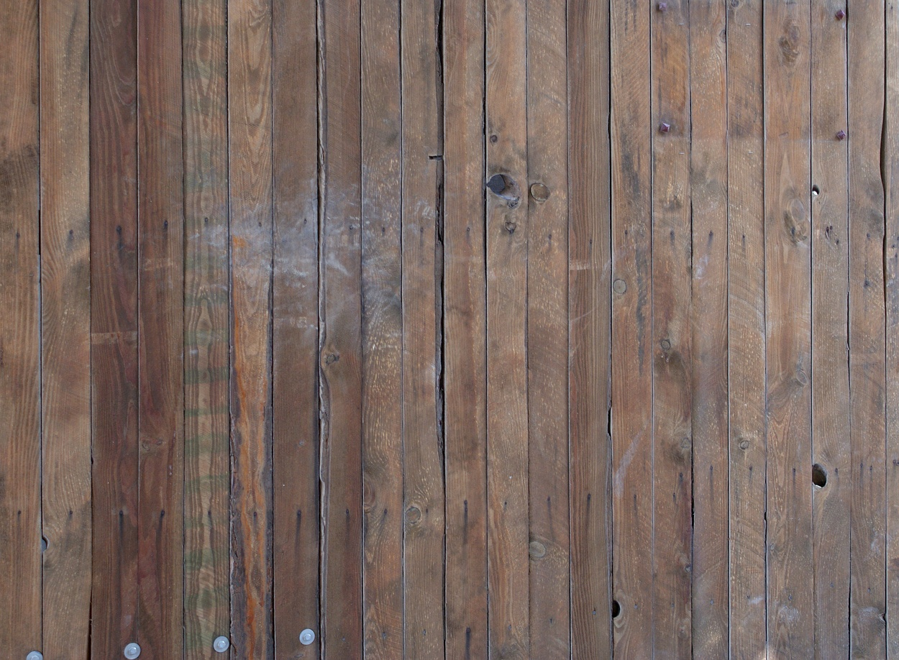
https://polyhaven.com/a/fine_grained_wood
https://textures.pixel-furnace.com/
http://texturer.com/set803/
http://texturer.com/set314/

Slide 2
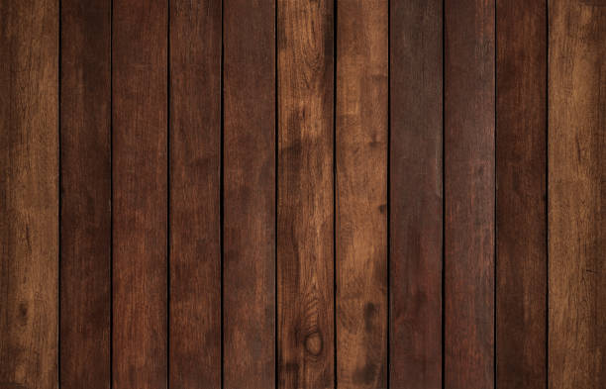
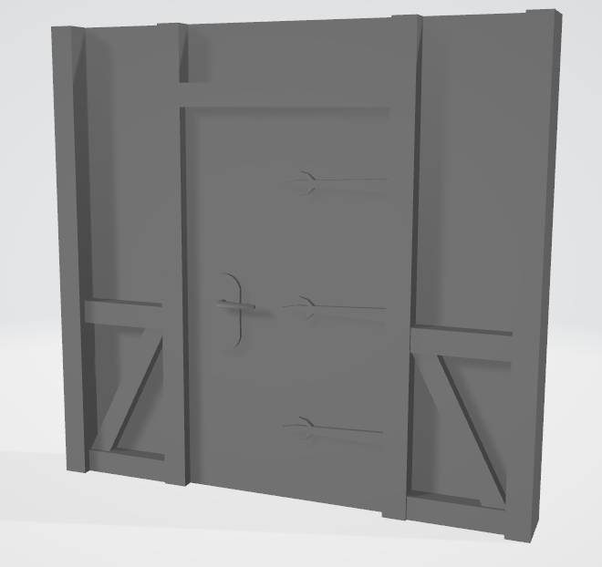
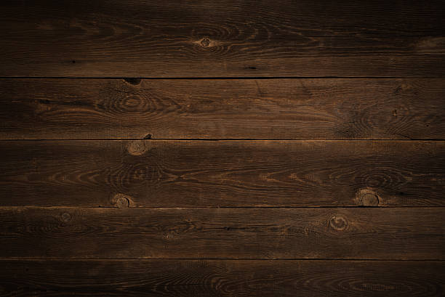
https://www.istockphoto.com/search/2/image-film?phrase=dark+wood+plank
https://www.istockphoto.com/search/2/image-film?phrase=dark+wood+texture

Slide 3
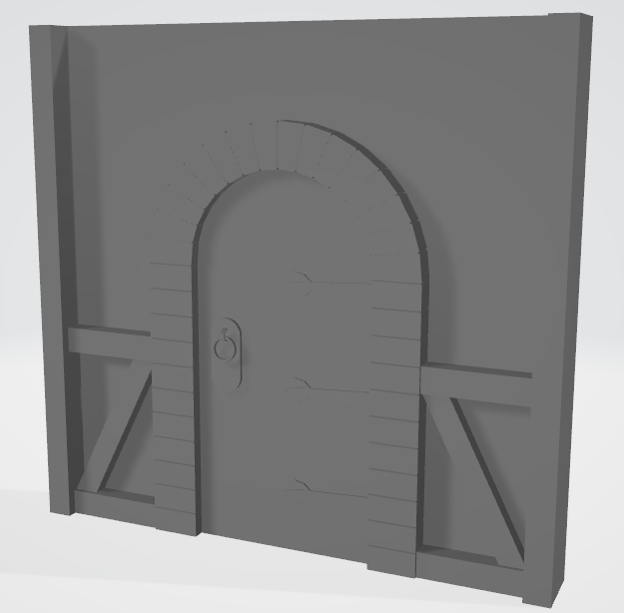
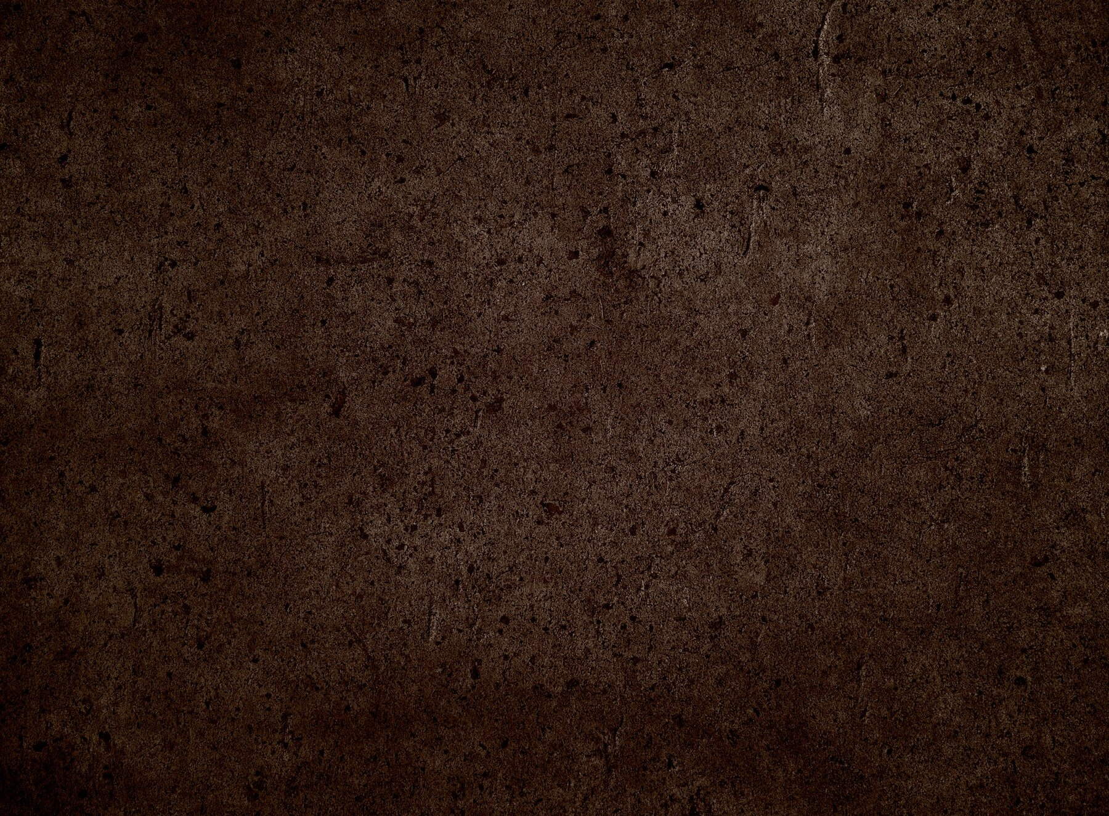
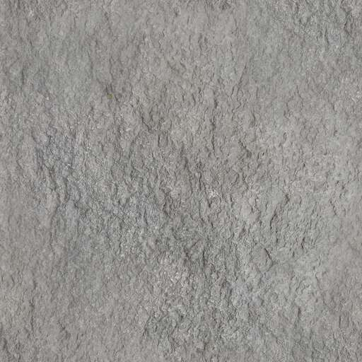
https://www.freepik.com/free-photo/dark-detailed-grunge-style-concrete-texture-background_19936756.htm#query=brown%20metal&position=37&from_view=keyword&track=ais&uuid=f2d18a42-9018-4d3e-b278-702c577505ef
https://www.manytextures.com/texture/199/gray-stone/

Slide 4
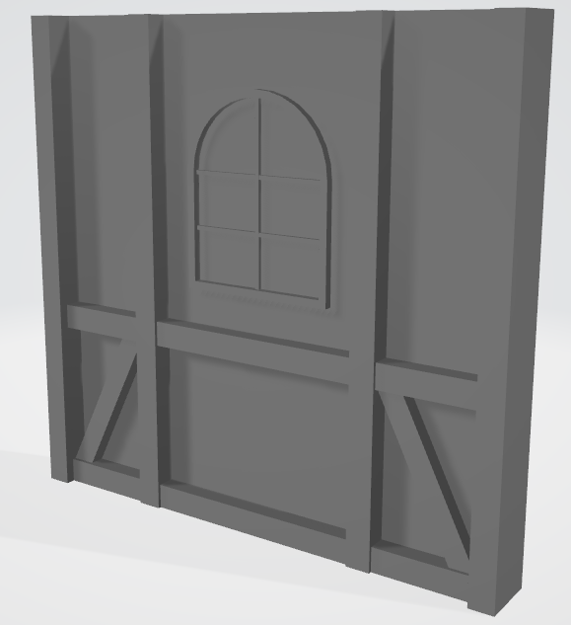

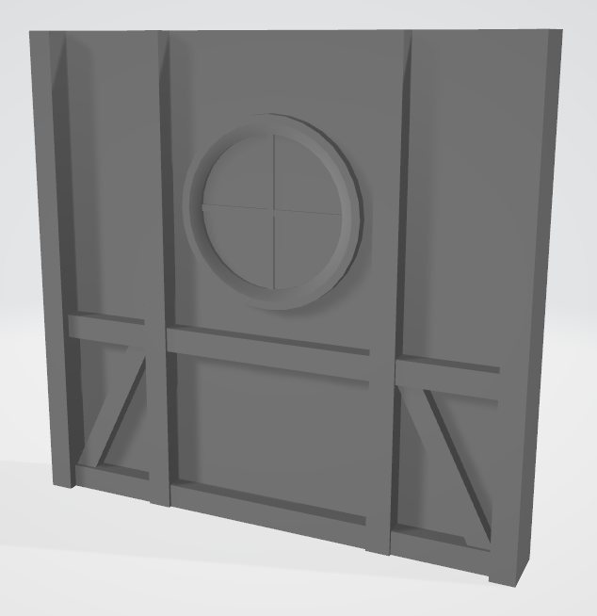
https://stock.adobe.com/search?k=glass+texture
Maya has built in glass material

